Slide 1
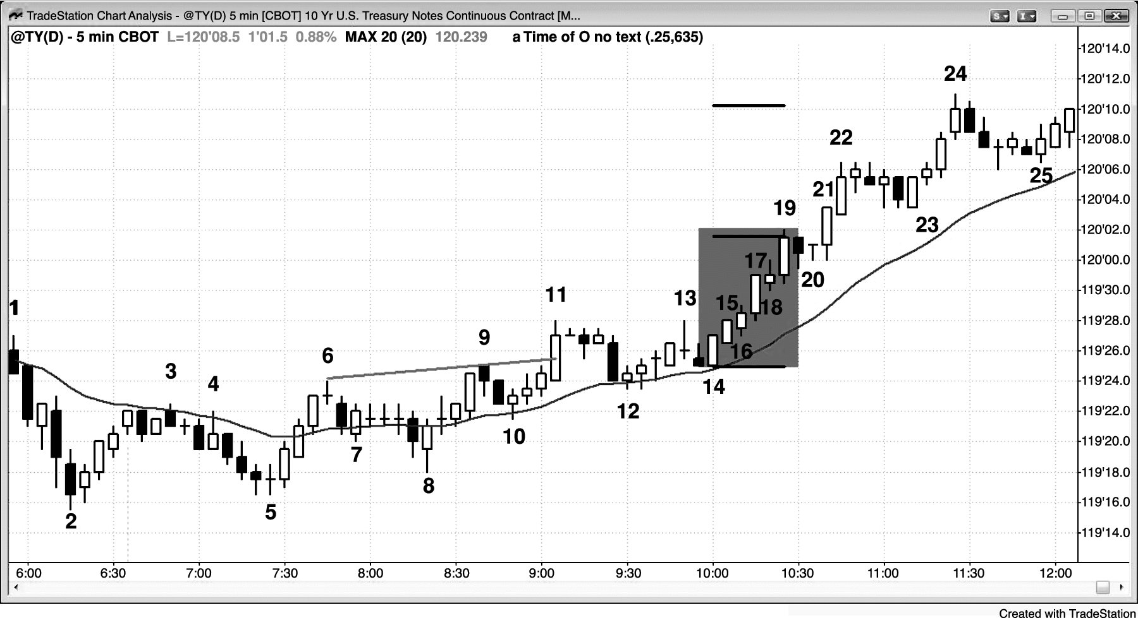
FIGURE 1.1 Breakouts Are Reliable Setups

Slide 2
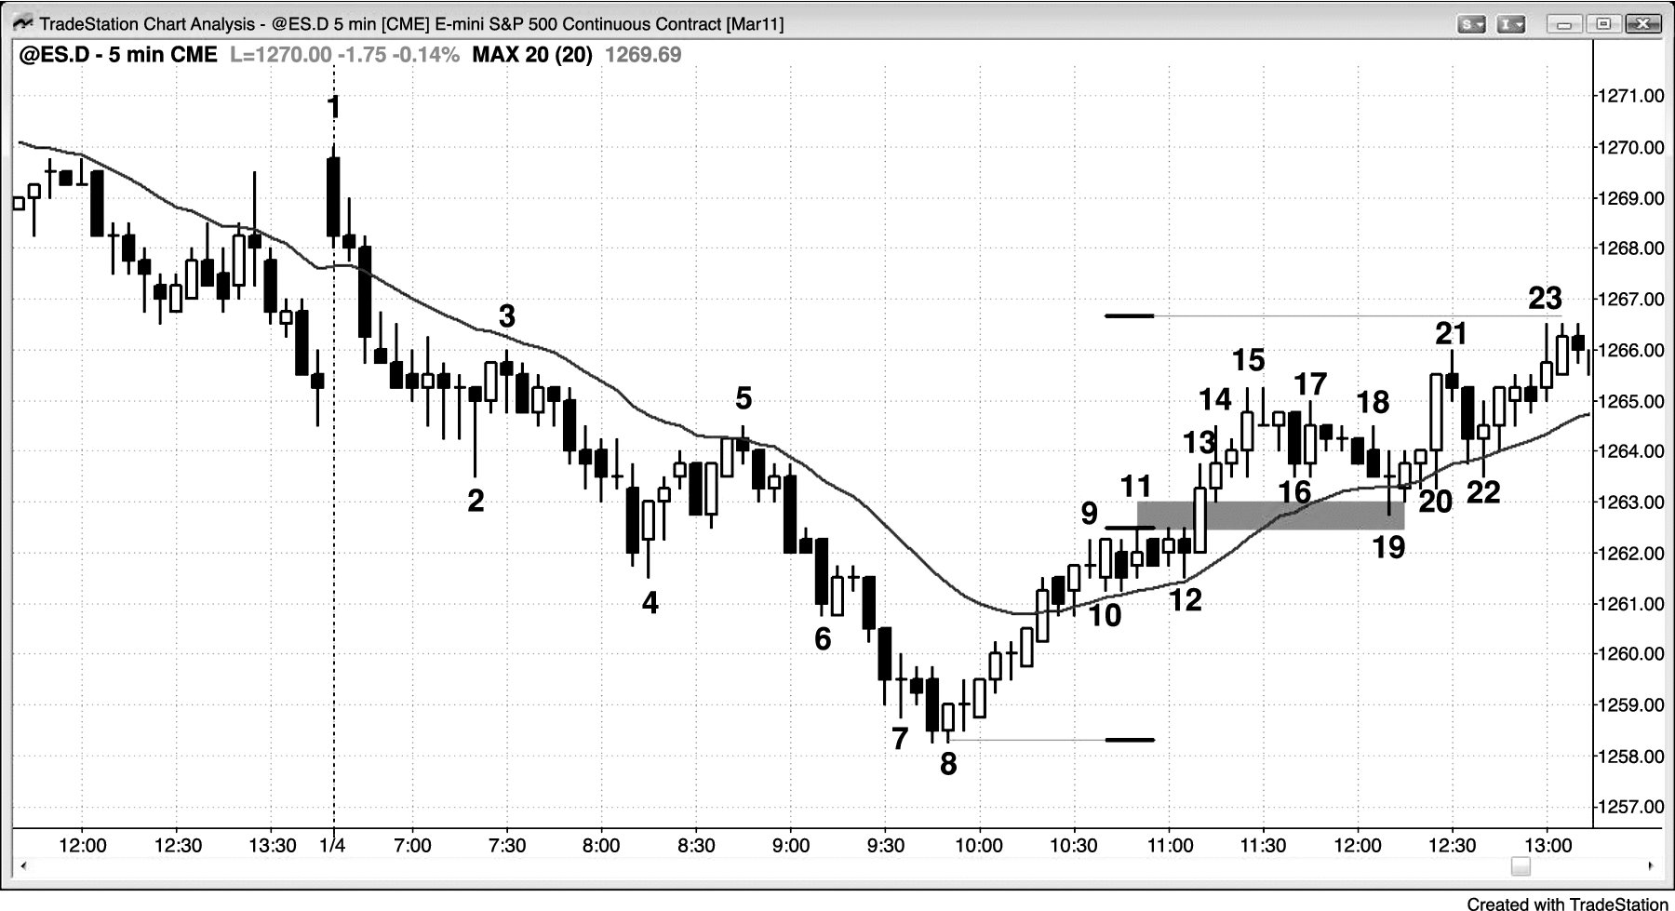
FIGURE 1.2 Breakout Pullback

